Slide 1
The Missionary Journeys of the Apostle Paul
The New Testament
Document #: TX002286

Slide 2
Summary of Paul’s Missionary Journeys
Biblical scholars believe that the Apostle Paul made three missionary journeys, plus a fourth, final journey to Rome. All four journeys are described in the Acts of the Apostles:
Journey 1: Acts 13:4—14:28
Journey 2: Acts 15:40—18:23
Journey 3: Acts 19:1—21:40
Journey 4: Acts 27:1—28:16
Notes:
Notes: For all four journeys in upcoming slides, be sure to show Paul’s route on the appropriate map. If you have not already done so, you may need to clarify that there are two cities called Antioch: one in Syria and one in Asia Minor.

Slide 3
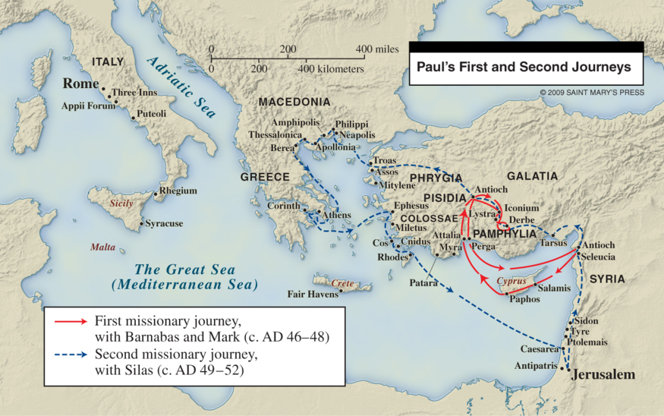
Journey 1 (Acts 13:4—14:28)

Slide 4
Journey 1 (Acts 13:4—14:28)
Paul’s traveling companions on this journey are Barnabas and John, who is also called Mark.
This first journey is the shortest of the three. It launches from Syrian Antioch and proceeds to the island of Cyprus, particularly the cities of Salamis and Paphos.
From Cyprus, Paul proceeds to Antioch in Pisidia (Asia Minor).
The journey continues to the cities of Iconium and Lystra and the region of Pamphylia in Asia Minor, concluding where it began, in Syrian Antioch.

Slide 5
Journey 2: Acts 15:40—18:23

Slide 6
Journey 2: Acts 15:40—18:23
Before the start of this journey, Paul and Barnabas go their separate ways. Barnabas travels with John, also called Mark, while Paul travels with Silas.
Like the first journey, the second journey begins in Syrian Antioch. It proceeds to the cities of Derbe and Lystra in Asia Minor, where Paul picks up a new traveling companion, Timothy.
They travel through Galatia and Phrygia and then to the city of Troas in Asia Minor, from which they sail to Europe. The European mission begins in the city of Philippi, in Macedonia, with the conversion of Lydia and her household.
Paul and Silas are imprisoned in Philippi; at their release, they continue on to Thessalonica, Athens, and Corinth.
Paul stays in Corinth for a year and a half (Acts 18:11) and returns to Syrian Antioch via Ephesus in Asia Minor and then Caesarea, north of Jerusalem.

Slide 7
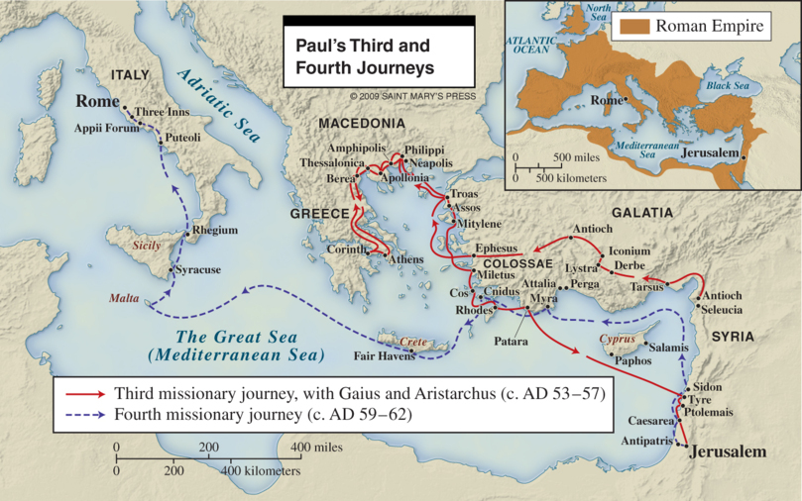
Journey 3: Acts 19:1—21:40

Slide 8
Journey 3: Acts 19:1—21:40
Paul’s third journey is the most extensive one. He travels with two Macedonian companions, Gaius and Aristarchus.
Like journeys 1 and 2, journey 3 begins in Syrian Antioch. From there, it proceeds across Asia Minor to Ephesus and into Macedonia, and then back again along a similar route.
From the cities of Rhodes and Patara in Asia Minor, Paul and his companions sail across the Mediterranean, past the island of Cyprus, landing in Tyre. From there they travel to Caesarea. Paul intends to go to Jerusalem, but many people discourage him, saying that he will be in danger there.
Paul disregards these warnings, maintaining that he is “prepared not only to be bound but even to die in Jerusalem for the name of the Lord Jesus” (Acts 21:13). He is in Jerusalem only one week before he is arrested.

Slide 9
Journey 4: Acts 27:1—28:16

Slide 10
Journey 4: Acts 27:1—28:16
As a Roman citizen, Paul exercises his right to appeal his case to Rome. When this appeal is granted, he leaves Jerusalem for Rome, accompanied by other prisoners and a centurion acting as a guard.
They sail from Sidon (in present-day Lebanon) across the Mediterranean Sea to Crete.
From Crete, they sail in stormy weather. After 14 days at sea, they are shipwrecked on the island of Malta, off the southern coast of Sicily.
They spend three winter months in Malta before sailing for Rome.
Paul’s ultimate fate is not known for certain. Most scholars maintain he was martyred in Rome around AD 65, although a few traditions suggest that he might have made an additional journey to preach in Spain.

Slide 11
General Information about All of Paul’s Journeys
Travel at this time was fraught with hazards, including all the difficulties that inclement weather can cause: shipwrecks, floods, impassable roads, and so forth.
Paul and his companions often endure persecution in the course of their travels, including being beaten, jailed, or expelled from particular cities.
In many cities, Paul initially focuses on preaching in synagogues—with Jews, converts to Judaism, and “God-fearers” (those considering conversion to Judaism) as the target audience.

Slide 12
General Information about All of Paul’s Journeys (continued)
This audience soon expands to include Gentiles. Sometimes Gentiles simply turn up as Paul is preaching; at other times Paul actively seeks them out, because the Jewish community has been inhospitable or unreceptive to the Gospel message.
Note that Paul visits some cities multiple times; many of these are the cities to whom he also addresses his Epistles (letters). These will be the subject of the next unit.

