Slide 2
The Old Testament
and the Trinity
Chapter 4
The Holy Trinity
© YuriyVlasenko/www.shutterstock.com

Slide 3
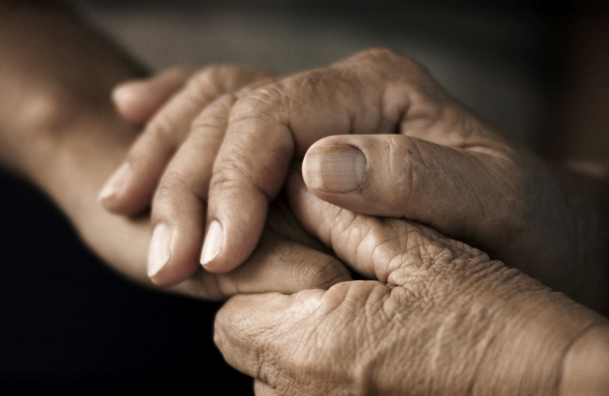
Chapter Summary The Holy Trinity
In this chapter, we will come to a deeper understanding of the mystery of the Holy Trinity. God has revealed God’s self to humanity as one God in three Divine Persons: Father, Son, and Holy Spirit. The Trinity reveals that God is love, and love by its very nature must be shared. Unrevealed, unshared love is no love at all! In this chapter we will come to appreciate that the love of God is shared in this communion of Divine Persons.
© RichardLyons/www.shutterstock.com

Slide 4
Introduction and “One God, Three Persons” (Handbook, pages 44–47)
The Trinity is the central mystery of the Christian faith—namely, that the one God has revealed himself in three Persons as Father, Son, and Holy Spirit.
Christian
Faith

Slide 5
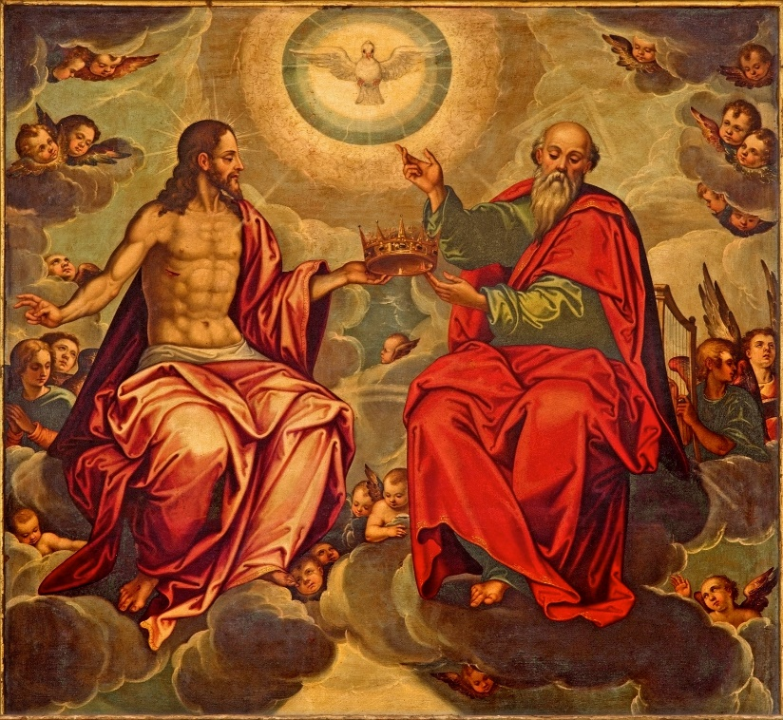
Introduction and “One God, Three Persons” (Handbook, pages 44–47)
The earliest Christians were Jewish and worshipped only the God of Israel, but through experience, they realized that the one true God was revealing himself as three Persons—the Trinity.
© RenataSedmakova/www.shutterstock.com

Slide 6
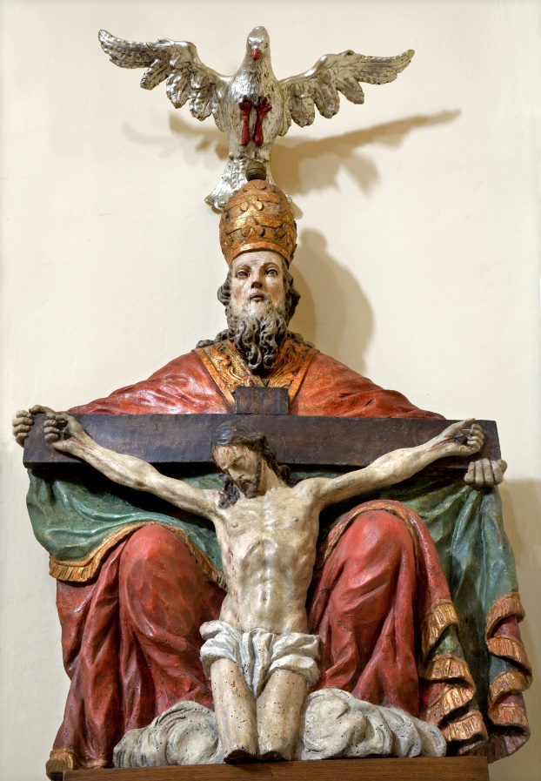
Introduction and “One God, Three Persons” (Handbook, pages 44–47)
The Trinity is the central mystery of our Christian life and faith.
The Trinity is three Divine Persons in one God who cannot be separated from one another, and the complete presence of God can be found in each of them.
© RenataSedmakova/www.shutterstock.com

Slide 7
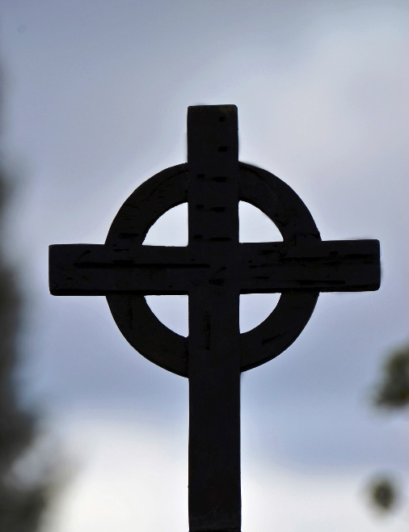
“The Work of the Trinity” (Handbook, pages 47–49)
Though God is one, and every action of each Divine Person is an act of the whole God, God’s works are more strongly associated with a particular Person of the Trinity.
Some of God’s works are more strongly associated with either the Father, the Son, or the Holy Spirit, but all the works of God are done by all three Divine Persons.
© Sitikka/www.istockphoto.com

Slide 8
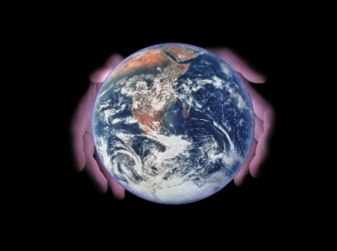
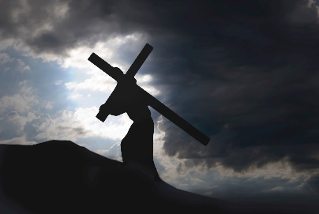
“The Work of the Trinity” (Handbook, pages 47–49)
God the Father is the First Person of the Trinity and is most strongly associated with Creation or with being the Creator.
© IvanJekic/www.istockphoto.com
The Son is the Second Divine Person and is most strongly associated with salvation or with being the Savior.
One God
© wwing/www.istockphoto.com
The Holy Spirit is the Third Divine Person. He inspires and guides and makes believers holy.
© TheDman/www.istockphoto.com

Slide 9
“The Trinity Is a Communion” (Handbook, pages 49–50)
The relationship between the Persons of the Trinity is one of perfect love and unity.
© VectorFrenzy/www.shutterstock.com

Slide 10
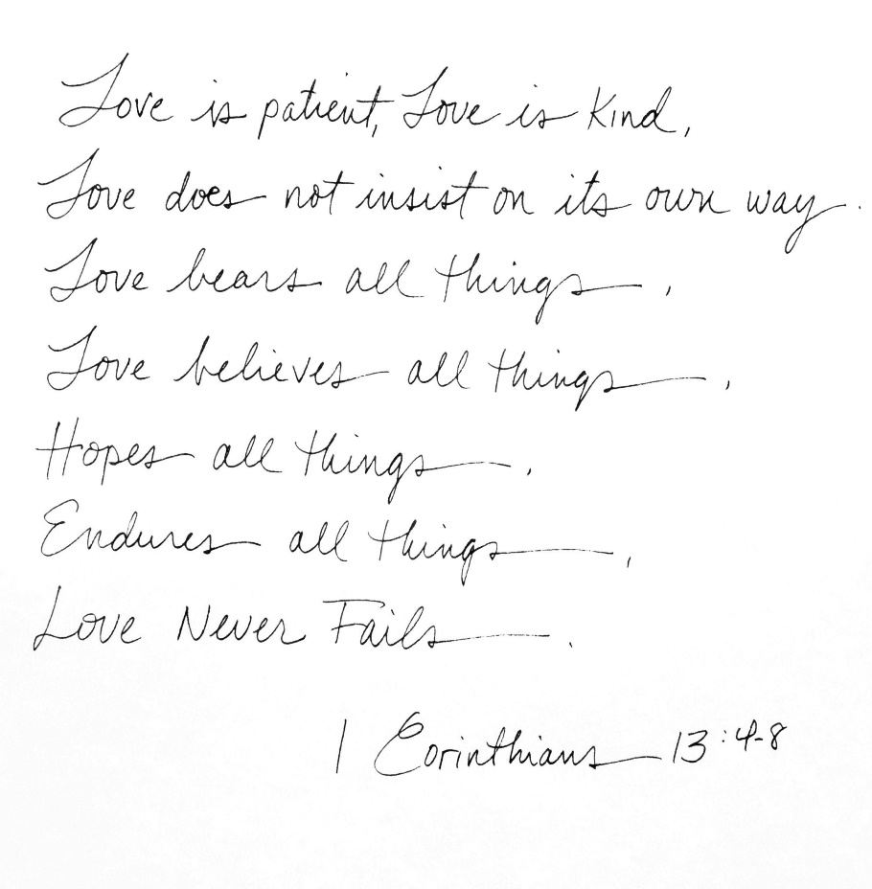
“The Trinity Is a Communion” (Handbook, pages 49–50)
The Father, Son, and Holy Spirit are completely in union with one another.
The love and unity that the Father, Son, and Holy Spirit share are perfect.
A vision for this perfect love is shared by Saint Paul in 1 Corinthians, chapter 13.
© MargaretMStewart/www.shutterstock.com

Slide 11
“Sharing in the Life of the Trinity” (Handbook, pages 49–50)
The love shared among the Persons of the Trinity pours out to us to share with family and friends and the rest of the world.
© MachineHeadz/www.istockphoto.com

Slide 12
“Sharing in the Life of the Trinity” (Handbook, pages 49–50)
God’s love—the love between the Father, Son, and Holy Spirit—is the source of all love.
The love and unity of the Father, Son, and Holy Spirit flow out to us and fill us so that we can share that love with others.
The love in our families should flow out in service to the rest of the community and the entire world.
© leonello/www,istockphoto.com

Slide 13
Let’s Reflect!
Think of a time when you experienced love from a family member, friend, teacher, or someone else. What did that look like? How did it impact you?
The love you received from these individuals came from the same source: the love of our Trinitarian God. What do you think about this?
Knowing that we give the love we first receive from God, what choices might you make that allow you to experience God’s love (for example, going to Mass or reading the Bible) so that you can share this love with others?

Slide 14
Acknowledgments
To view copyright terms and conditions for Internet materials cited here, log on to the home pages for the referenced websites.
During this presentation’s preparation, all citations, facts, figures, names, addresses, telephone numbers, Internet URLs, and other pieces of information cited within were verified for accuracy. The authors and Saint Mary’s Press staff have made every attempt to reference current and valid sources, but we cannot guarantee the content of any source, and we are not responsible for any changes that may have occurred since our verification. If you find an error in, or have a question or concern about, any of the information or sources listed within, please contact Saint Mary’s Press.

