Slide 1
The Promise of a Messiah
The Catholic Faith Handbook for Youth, Third Edition
Chapter 7
Document #: TX003138
Notes:
Use this presentation to review the Old Testament covenants covered in chapter 7 of the student handbook.

Slide 2
Copyright: Kevin Carden / www.shutterstock.com
Notes:
Explore with the students the metaphor of marriage as a way of explaining the concept of covenant, as on page 73 of the student handbook. Invite the students to expand the meaning of faithfulness in marriage, beyond the idea of not committing adultery.

Slide 3
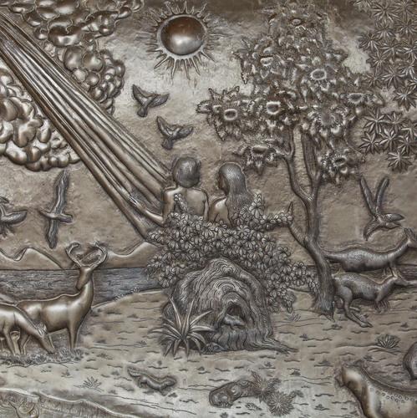
God’s Promise to Adam and Eve
Promise: A Savior who will destroy evil
Copyright: WitthayaP / www.shutterstock.com
Recipients: Adam and Eve, representing all of humanity
Fulfillment: Jesus will win the battle with evil
Notes:
Read Genesis 3:15, or ask a student to do so. You may wish to identify this message as the Protoevangelium, a kind of precursor to the Good News of salvation revealed in Jesus.

Slide 4
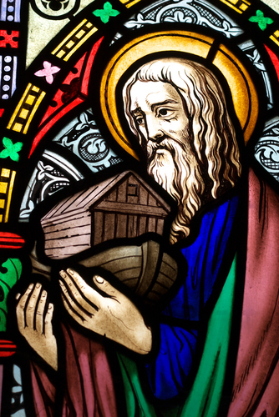
The Covenant with Noah
Promise: God will never again send a flood to destroy life on earth
Recipients: All nations of the earth
Fulfillment: Jesus extends the New Covenant to all
Copyright: Sybille Yates / www.shutterstock.com
Notes:
Read Genesis 9:8–11, or ask a student to do so. You may wish to add that the sign of this covenant, identified in verse 13, is the rainbow.

Slide 5
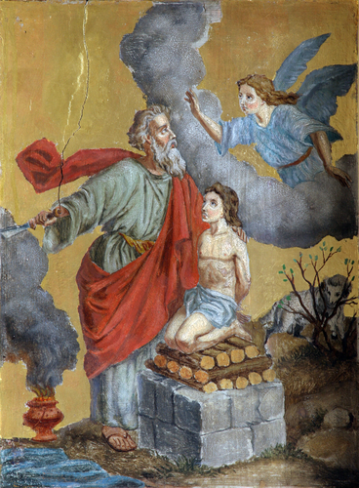
The Covenant with Abraham
Promise: a great nation of descendants, with their own land, who will be a blessing for all nations
Recipients: The Chosen People, descendants of Abraham and Sarah
Fulfillment: Abraham’s descendant, Jesus, brings blessings to all nations
Copyright: Zvonimir Atletic / www.shutterstock.com
Notes:
Read Genesis 12:1–3, or ask a student to do so. Explain that this covenant is also called the Covenant of Circumcision, because that is the sign of faithfulness the covenant requires.

Slide 6
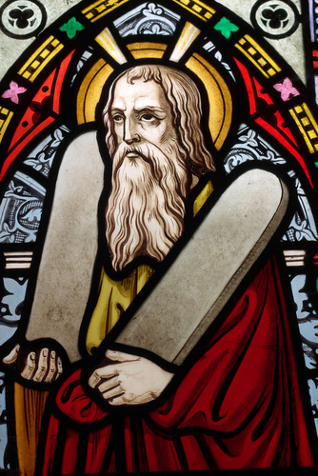
The Covenant with Moses
Promise: Renewal of the Abrahamic Covenant
Recipients: The Chosen People, freed from slavery in Egypt
Copyright: Sybille Yates/ www.shutterstock.com
Fulfillment: Jesus fulfills the Law through perfect obedience to God
Notes:
Read Exodus 19:1–6, or ask a student to do so. Explain that God expects his people to keep the Law he has revealed to them, summarized in the Ten Commandments.

Slide 7
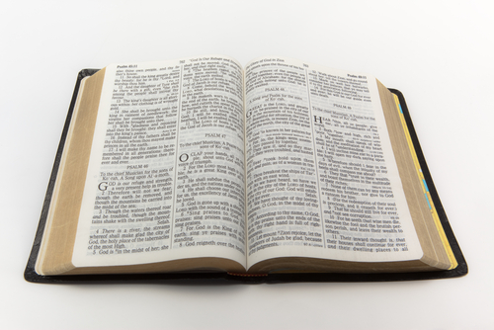
“And I will walk among you, and will be your God, and you shall be my people” (Leviticus 26:12).
Copyright: Richard Lowthian / www.shutterstock.com
Notes:
Invite the students to reflect on what it would mean if someone were to say to us, “I will be your friend.” Ask what kind of commitment is implied in this covenant statement in Leviticus, repeated so often in the Old Testament.

Slide 8
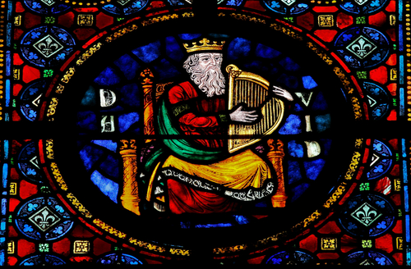
Covenant with David
Promise: The Covenant with David
Recipients: David’s dynasty and all its subjects
Fulfillment: David’s descendant, Jesus, established the Kingdom of God for all eternity
Copyright: jorisvo / www.shutterstock.com
Notes:
Read 2 Samuel 7:8–13, or ask a student to do so.

Slide 9
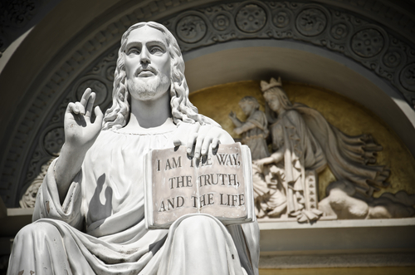
Prophecies of a Messiah
Visions of a New Covenant and a heavenly Kingdom were revealed to the prophets.
Copyright: erburenustudio / www.shutterstock.com
The prophets gave the Chosen People hope for a restoration of humanity’s relationship with God.
Jesus brings the Messianic prophecies to complete fulfillment.
Notes:
Invite the students to look over the chart on pages 81 and 82 of the student handbook. You may wish to choose one of the readings for further discussion.

