Slide 1
Studying the World’s Religions
World Religions: A Voyage of Discovery
DOC ID #: TX003938

Slide 2

Academic Study of Religion
Modern universities emerged from institutions in Europe that integrated religious pursuits with academic study.
Today, academic study of religion is commonly distinctive from doing religion.
© Andrei Nekrassov / www.shutterstock.com
• The academic study of religion emphasizes
free inquiry and critical examination.
Notes:
Founded as far back as 1096, Oxford University (pictured on this slide) is the first university in the English-speaking world (the University of Bologna in Italy was founded in 1088). For centuries, universities quite naturally mixed the doing of religion (theology) with academic studies. The academic study of religion has emerged within universities over the course of the last 150 years, with the pace and proliferation increasing significantly beginning in the 1960s. Exploring the website of the American Academy of Religion (AAR) with the students is an effective means of revealing the current scope of academic study of religion: for example, the “Program Units” list, accessed by linking from the homepage to “Meetings” and then to “Annual Meeting,” provides an immediate look at the many specific areas of study. As stated in its Mission Statement, the AAR strives to provide “a context of free inquiry and critical examination.” If it’s not clear to the students already, it might be helpful to point out that the student book is written from the point of view of the academic study of religion.

Slide 3
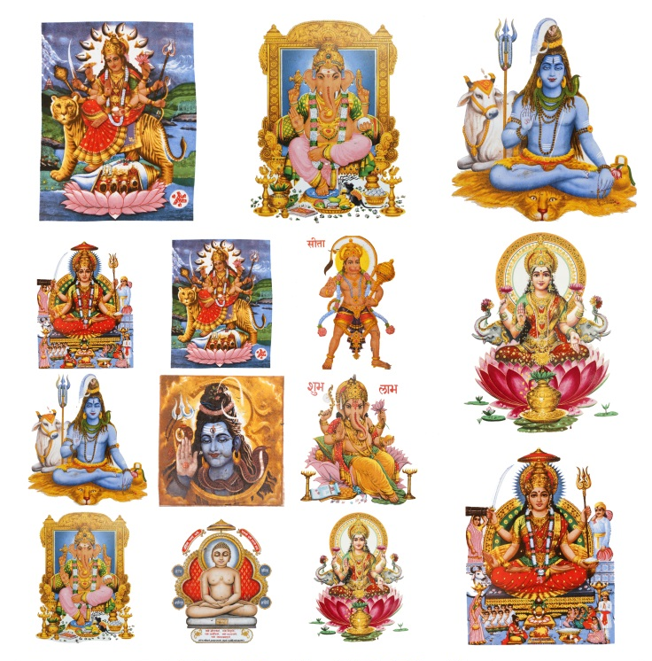
The Doctrinal Dimension:
Ultimate Reality
The doctrinal dimension of religion includes beliefs about ultimate reality.
Most religions are either theistic or nontheistic.
Most Hindus, for example, are polytheists while also being monists.
© Malgorzata Kistryn / www.shutterstock.com
Notes:
Hinduism is relatively complex with regard to doctrinal positions on ultimate reality. Polytheistic religious traditions abound, especially among indigenous peoples or in strands of “folk religion” that commonly accompany major traditions. Ancient Greek and Roman Stoicism, a relatively less familiar religious worldview, is a clear example of pantheism. Shinto, with its vast array of kami and its reverence for nature, can be said to come close to being pantheistic, although the kami are conceived as being individual entities and therefore do not pervade all of reality. Deism, based on Enlightenment ideas, was a popular doctrinal stance of some of the founding fathers of the United States. The following chart provides a quick study of doctrinal positions on ultimate reality:
Theism Belief in the existence of God or of gods
Atheism Belief that there is no god
Nontheism Lack of belief in the existence of a god who is of vital significance
Agnosticism Belief that it is not possible to know whether there is a god
Polytheism Belief in the existence of many gods
Monotheism Belief in the existence of only one god
Deism Belief that a god exists but is not personally involved in the world
Pantheism Belief that the divine exists in everything
Monism Belief that all reality ultimately is made up of only one essence

Slide 4

The Experiential Dimension
Moses’ encountering the Burning Bush is an example of the experiential dimension.
Moses had an encounter with God and a mystical experience.
This event is set forth in the sacred narrative of the Book of Exodus and therefore also involves the mythic dimension.
© BasPhoto / www.shutterstock.com
Notes:
Moses’ encountering the Burning Bush is recounted in Exodus, chapter 3. Though the story of the Exodus is not so purely mythic as is the Genesis account of Creation, sacred narratives like this are aspects of the mythic dimension. Religions’ foundational experiential events frequently are set forth in mythic fashion. In contrast to the experience of encountering God, a mystical experience is characterized by communing or uniting with the ultimate reality through inward contemplation. Can the students identify other examples of religious experience? Can they identify examples of such experiences being crucial to the origin of the religion? Examples include Buddha’s experience of enlightenment and Muhammad’s experience of being called to be a prophet. Along with the mystical experience (e.g., Buddha’s enlightenment) and the encounter with God (e.g., Muhammad’s call, through the angel Gabriel), scholars cite a variety of others, such as the shamanic experience and glossolalia (“speaking in tongues”) and other ecstatic experiences.

Slide 5

The Ethical Dimension:
The Golden Rule
Christianity’s “Golden Rule”
is set forth in Matthew 7:12.
Many of the world’s religions embrace basically the same teaching.
Comparing similarities and differences among religions
is highly instructive.
cstar55 / www.istockphoto.com
Notes:
Google “golden rule world religions” and you’ll find various websites that conveniently cite similar ethical teachings across a spectrum of traditions. One example (but note that it’s Matthew 7:12, not 7:1) is http://www.teachingvalues.com/goldenrule.html.
Religions can be fruitfully compared with regard to this common ethical teaching by considering, for example, what text or figure sets forth the teaching, what sort of authority (divine or otherwise) lies behind it, and what its implications are for the quest for salvation.

Slide 6

The Ritual Dimension:
Prayer and Meditation
Prayer and meditation are practiced extensively by Buddhists.
Prayer is more common in theistic religions, meditation in nontheistic religions.
Prayer and meditation also commonly involve the experiential dimension.
© Cyril Hou / www.shutterstock.com
Notes:
If appropriate, this slide might provide a good opportunity to ask the students to consider, and perhaps even to speak about, experiences that they’ve had with prayer, meditation, or the like. A more objective approach to engaging this slide might involve asking the students to identify other examples of the ritual dimension, and then to compare them. Because religious experience is typically difficult to describe or even to conceptualize, explaining to students the common overlap between the ritual and experiential dimensions might prove difficult. The historical example of Gautama the Buddha, who attained enlightenment while meditating, is one means of highlighting the point.

Slide 7

The Ritual and Social Dimensions:
A Marriage Ceremony
Life’s important transitions often are marked by religious rituals.
Marriage ceremonies ritually sanctify the transition in the presence of family and community, helping to secure societal affirmation of the couple’s new status.
Marriage affects the societal structure of the community.
© Lily Rosen - Zohar / www.shutterstock.com
Notes:
The students might be asked what other important transitions are marked by religious rituals. The students might also be asked to reflect on weddings that they have attended, and to comment on the societal aspects, including the role of the ceremony in securing societal affirmation. In general, what purposes might be served by ritually sanctifying the transition into married life?
The image shown here is of a ketubah, or Jewish marriage contract, which is signed before the wedding ceremony and names the husband’s obligations to his wife. Traditionally, the contract is read aloud under the huppah, or canopy.

Slide 8

T’ai Chi
In China, t’ai chi is often practiced in public places.
T’ai chi is commonly practiced for such non-religious objectives as improving health and providing self-defense.
T’ai chi nonetheless has religious roots in the
Taoist tradition.
TonyV3112 / www.shutterstock.com
Notes:
(T’ai chi is the common English name; the Chinese name is t’ai chi ch’uan, also transliterated as taijiquan.) The “chi” in this name (ji in the Pinyin transliteration system) is not to be confused with ch’i (qi in the Pinyin system), although t’ai chi does involve the harnessing of ch’i (“breath,” “energy,” or “force”) and integrating it for the purpose of bodily and spiritual health and balance. This slide depicts t’ai chi being practiced in Yangzhou, China. Especially in China, where the government does not condone religion, public practice of t’ai chi is not considered to be religious ritual. But given its roots in the Taoist tradition, t’ai chi is an example of the combination of traditional religious and modern secular aspects.

Slide 9

Yoga
In Hinduism, yoga is an important example of the ritual dimension of religion.
For many in the West, yoga is a form of exercise and relaxation and is not religious.
Traditional religious and modern secular aspects intermingle in yoga.
© Kiselev Andrey Valerevich / www.shutterstock.com
Notes:
In Hinduism, yoga refers generally to physical and psychological techniques for spiritual advancement, and therefore is a religious ritual. In December 2012, a protest over the teaching of yoga in a public school in Encinitas, California, focused attention on issues involving separation of church and state and the possibility of inappropriate religious indoctrination: http://www.nytimes.com/2012/12/16/us/school-yoga-class-draws-religious-protest-from-christians.html?_r=0.
This issue could be discussed with the students, whether drawing on specifics or just discussing more generally.

Slide 10

The Material Dimension: Earth
The material dimension of religion includes natural entities.
Some religions regard the earth as sacred.
Other religions regard the earth as part of the creative work of God (or gods).
The earth also symbolizes
the plurality of religions around the globe.
© leonello calvetti / www.shutterstock.com
Notes:
Of the major traditions studied in the student book, Taoism and Shinto place the most emphasis on the sacredness of nature and of the earth. Native American traditions and many traditions of indigenous peoples in other regions also emphasize this. Chapter 15 includes a section called “Nature Religion: Worshipping Mother Earth.” Regarding Earth as part of the creative work of God, consider discussing with students the implications for Judaism and Christianity in Genesis, chapters 1 through 3.

Slide 11

The Material Dimension:
Religious Symbols and Civil Religion
United States currency bears the statement “In God We Trust.”
The First Amendment to the U.S. Constitution mandates separation of church and state.
“In God We Trust” suggests a kind of “civil religion.”
© Asaf Eliason /www.shutterstock.com
Notes:
“In God We Trust” appears on both coinage and paper money. To state the obvious, this slide provides opportunity for discussion of a wide range of issues. The First Amendment could be explored in more depth, as could civil religion (on which the essential scholarly works are by sociologists of religion Robert Bellah and Phillip Hammond). The discussion might best be had after also considering the next slide.

Slide 12

The Material Dimension:
Hindu Religious Symbolism
The government of India has issued postage stamps with religious symbolism.
The Hindu trimurti features the gods Brahma, Vishnu, and Shiva.
Compare “In God We Trust” on United States currency.
brandonht / www.shutterstock.com
Notes:
Brahma is the Creator, Vishnu is the Preserver, and Shiva is the Destroyer. The stamp that is shown on this slide was issued by the government of India in 1949. India is the world’s largest democracy and, like the United States, upholds a secular system of governance. Presently 79.5% of the population of India is Hindu (http://www.pewforum.org/global-religious-landscape-hindu.aspx), comparable to the United States’ 78.4% population of Christians (http://religions.pewforum.org/reports). The students could discuss, in light of these circumstances, the extent to which religious symbolism on U.S. currency is similar to symbolism on Indian postage.

Slide 13

The Material Dimension:
Devils Tower
Devils Tower is a sacred entity for many tribes of the North American Plains.
For others, Devils Tower is a popular tourist destination.
The material dimension of religion encompasses natural and manmade entities.
© Tom Grundy /www.shutterstock.com
Notes:
The National Park Service provides synopses of various Native American myths and legends regarding how Devils Tower came to be: http://www.nps.gov/deto/historyculture/first-stories.htm
The website’s homepage notes that “over 20 tribes have a cultural affiliation with Devils Tower.” The National Park Service has implemented a management plan that includes voluntary avoidance of Devils Tower for rock climbing during June, the period during which the Lakota traditionally have held the Sun Dance there.

